Slide 1
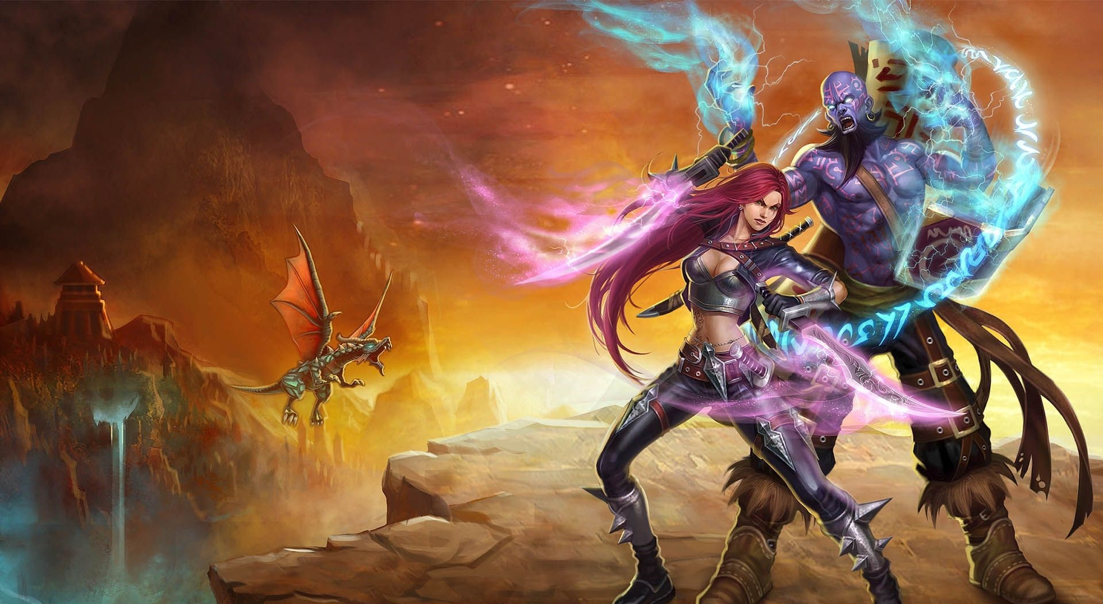
Cooperation
v/s
Competition
Why helping matters !
Gautam Baghel
Feb 15, 2017

Slide 2

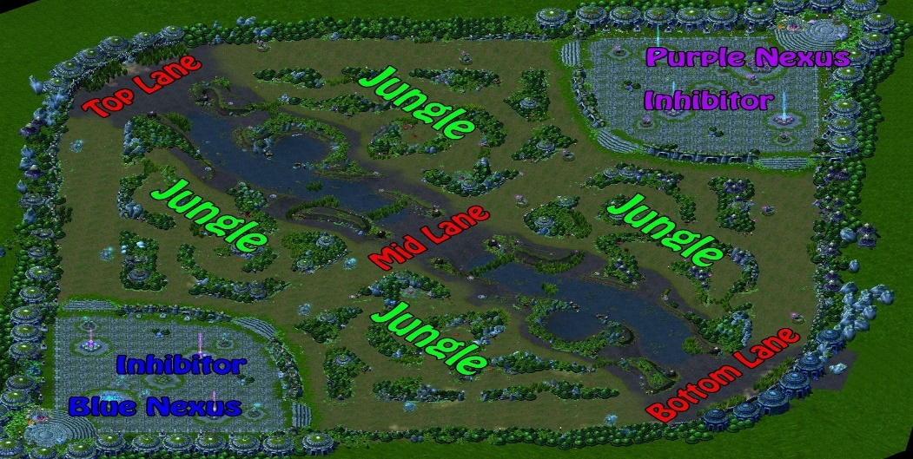
Game Intro
League is a MOBA
Multiplayer online battle arena game.
Two teams with 5 players in each
Different classes of players like magic, predator, assault etc.
5 Major player roles- Top, Bottom, Mid, Forest and Support
PS: No one aims to be support.

Slide 3
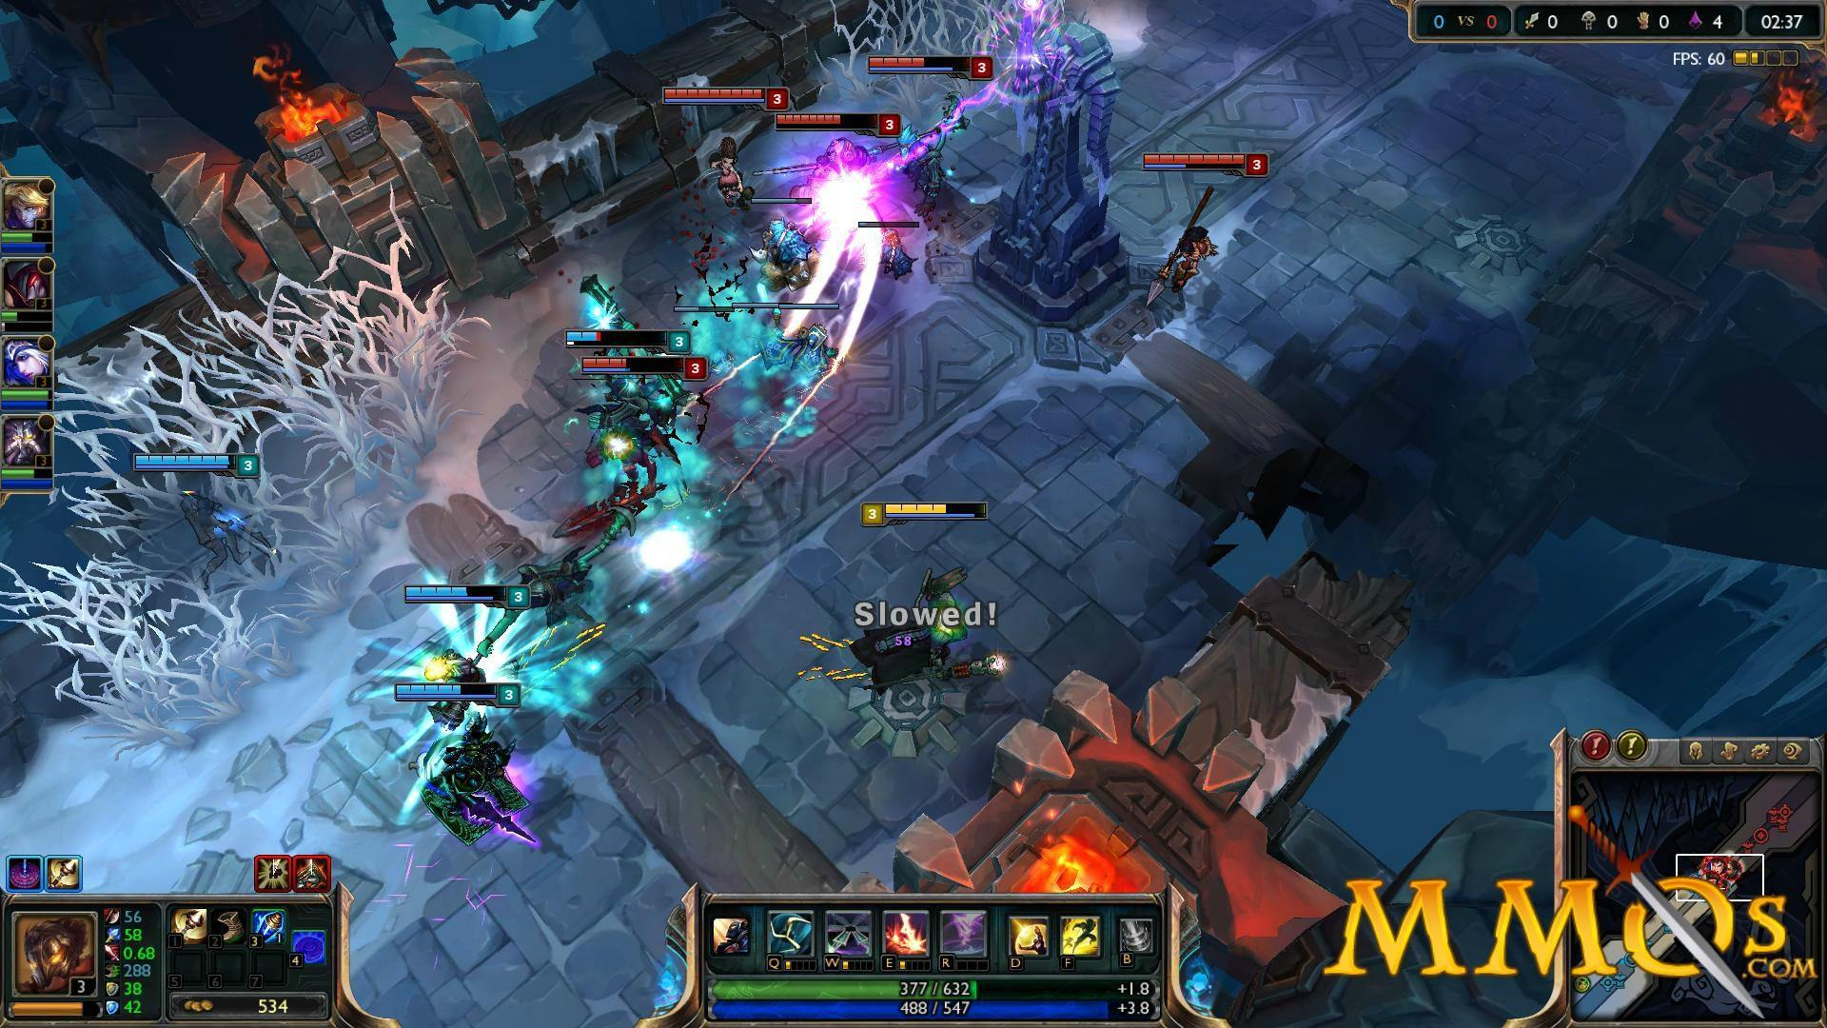
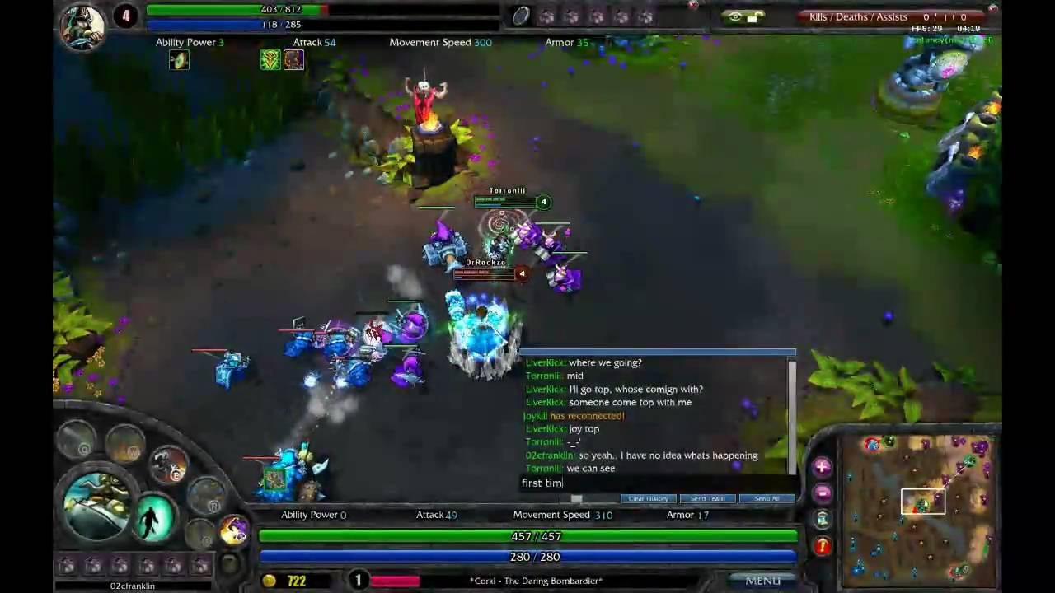
Star Player
Typical examples will include hogging resources. Trying to “Outshine” others
THE PROBLEM
Team Player
Shares resources agrees with teammates. Gets left out in charts and rankings.
Why would I give something if I can have it all ? Especially if I have the opportunity.

Slide 4
PREVIOUS WORK
1
2
3
4
Class based team
Player roles in team
DOTA 2: team comp.
Player Skill in MOBA
They tried to explore the game based on classes selected by a team. They tried to predict whether specific set of classes when groups leads to higher chances of victory used (LDA,QDA and clustering)
They tried to divide teams into set of classes and predicted that roles defined by them proved to win significantly higher then randomly playing the game without a particular role (many algos use)
They used 3 orders of PCA to analyze each hero and their role in the match. They came up with a set of players which essentially lead the team to victory but were ineffective in the initial stage of the game.
Paper by Magy and Chen on player’s skill to successful play. They gathered bunch of data and they found base skill of player, base skill of champion and player’s champion specific skill to be essential.

Slide 5
VS
Team
Player
Team and Player Comparison
What do I mean by this ?
Why does this matter ?
How composition affects this?
Predefined teams v/s generated teams

Slide 6




MY APPROACH
Read the data
Millions of data files available on riots API
Parse the file
Include the things relevant to the research and clean the data.
Fit into algorithm
Use predefined set of R functions to predict
Test
Use 10 fold cross validation to check whether the results are consistent

Slide 7
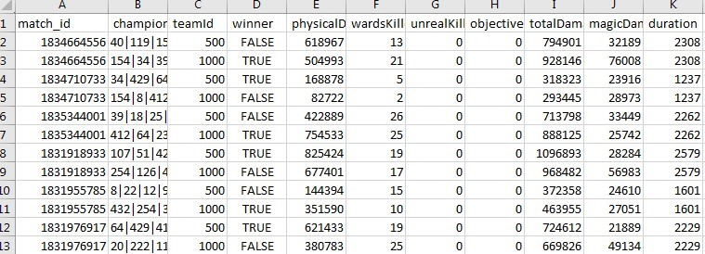
DATA PARSING
Initial data needed to be divided based on team and star players
Final data(Parsed)
4
3
Consider every player with highest gold
earned and low assist
as star player
2
Add most column
member for team
data
1
Take the data

Slide 8
SLIDE TITLE
LDA
Linear discriminant analysis – basically tries to distance different things and bring together same type of things
1
-------------
2
Logistic Regression
Tries to create a sigmoid function to base categorical values to form a continuous function
Different Classification and Clustering I used
-------------
3
QDA – Quadratic discriminant
Same thing as LDA but the relationship between the data may be exponential(quadratic)
-------------
Decision Tree
Given finite number of choices creates children and sub nodes to reach certain state
4
-------------
5
Clustering
Unsupervised form of learning, groups people together who have similar tendencies.
-------------

Slide 9


SINGLE ANALYSIS RESULTS
FINAL RESULTS
Table shows the result of each algorithm used after 10 fold cross validation
 | Model |  | mean F1 score TEAM |  | mean F1 score STAR
 | LDA |  | 0.772 |  | 0.748
 | QDA |  | 0.77 |  | 0.741
 | Logistic Regression |  | 0.769 |  | 0.747
 | Decision Tree |  | 0.73 |  | 0.692
TEAM 77%
STAR 74%
Team based approach shows a higher probability of winning by 3~4 %
Star based approach remains on the lower side of the spectrum relatively.

Slide 10
RESULTS
1
Significance
Three to four percent difference may not seem significant but in a high league game where stakes are high it will make a huge difference. Who cares? Company does, to keep players satisfied and hooked riot ensures that players get involved with each other.
2
Correctness
To be sure the result we got are valid for every prediction made a 10 fold cross validation is performed. Team division based on assists suggest only the most cooperative player and high gold low assist assure star player.
3
Factors not considered
Riots internal mechanism to form teams may already be factoring this thing to forming teams since balance in both the teams is quintessential. It can intentional or unintentional.

Slide 11






CONCLUSION AND WHAT I WANTED TO INCLUDE
Elements in the game to include to balance star play behavior
Team based gameplay better than star-play DONE!
Work to be done, riots internal mechanisms may affect results
Identify potential matches which are team fixed
Somehow include Game theory into this!
Work in progress for clustering algorithm
Free PowerPoint Templates

Slide 12
END
QUESTIONS OR COMMENTS ??
Thank you !

